Slide 1
Asymmetric copula in multivariate flood frequency analysis
Hannes Grün, Robin Schüttpelz

Slide 2
Relevance
Floods: Among most severe natural hazards worldwide
Multivariate flood analysis: Interdependence of flood event characteristics
Asymmetric copula functions: Varying strength of dependence between variables, allowing flexible modelling.

Slide 3
Dependence Structure
Relevant Variables: Flood peak (P), Duration (D), Volume (V).
Influences on Dependencies: P affects dependence structure between D & V
Relevant Influences: Portray multivariate dependencies in accurate manner

Slide 4

Copula
Joint CDF with uniform margins
Decouples margins and dependence
NAC allow (partial) asymmetry
$$C\left(u_{1},u_{2},u_{3}\right)=C_{1}\left({u_{3},C}_{2}\left(u_{1},u_{2}\right)\right)$$
Notes:
Will not introduce a lot of theory
Keep it intro level friendly
Thus:
Applied NAC example
Basic theory:
Copula is a joint cdf with uniform margins (more on that later. For now think of it as just a function)
Allows to decouple marginal distribution and dependence strucutre
NAC special AC that allow partial asymmetry FORMULA
CDF:
- Function that gives probability X<= x

Slide 5
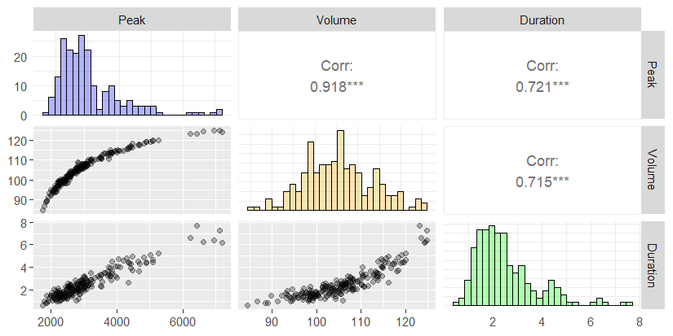
Example
Notes:
Barplot, Scatterplot and Kendall‘s tau
Note on Kendall‘s tau: Think of it as more robust Pearson correlation coefficient

Slide 6
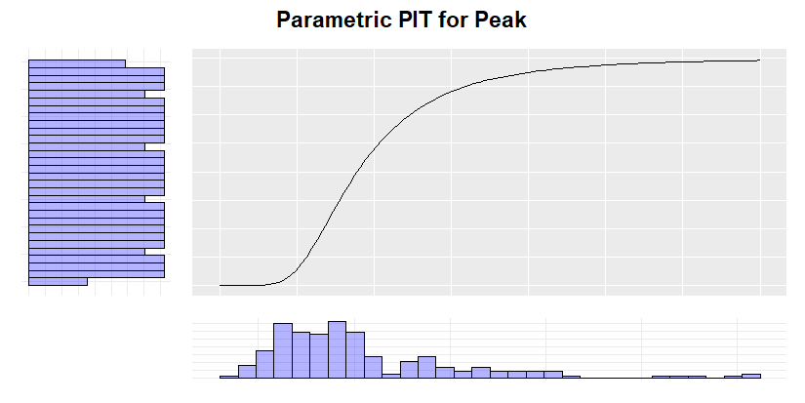
Probability Integral Transform
Notes:
Concept of PIT:
We used empirical CDF
> Then, CDF is step function and not smooth
> The transformed variables are „psuedo obs“

Slide 7
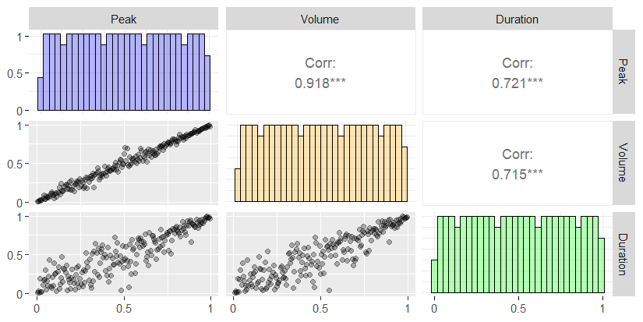
Pseudo Observations
Notes:
Where the copula comes into play:
Scatterplots transformed
> uniform margins
> BUT considering dependence, just for the pseudo obs however
We can fit copula TO THIS structure, that is, only the pseudo obs ie. INDEPENDENT of the margins
Thus, we fit dependence INDEPENDENT of the margins. They can be of any shape → This is what paper discusses
ALSO We see that
Copula (Note towards asymmetry in Scatterplots and Limitations of NACs)
Using PIT, we obtain pseudo observations
R sim for PIT?

Slide 8
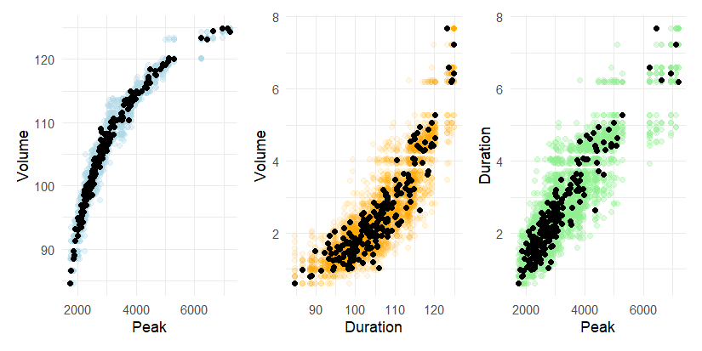
Goodness of Fit
Notes:
So far:
Could reproduce paper result using NACs on simulated data
(Ses example)
How to proceed?
But, what is expected of us for our paper?
We have 2 Outlook, but we are not sure which way to go

Slide 9
Outlook (1)
Examination of channel characteristics: Effect of slope, width, surface roughness, etc. onto dependence structure V and D
Statistical issues:
Variable behavior → How to deal with constants?
Are all variables even relevant? i.e. variable selection for copulas?
If many variables are relevant, NACs are not really suitable → Vine copulas?
Is this too much for 15 pages?
Notes:
Potential further variables: Slope, Width, Underground surface, …
Statistical issues:
>Some variables are constant within a measuring station. How can we measure its influence then? Must we combine data from stations? If so, do mixed copulas arise (naturally)? Are mixed copulas even meaningful here? How to statistically reliable examine these dependencies??
> Can variable selection be „outsourced“?
NACs are not really suitable for high dimensions (computational complex, limited flexibility / partial exchangeable) → Are Vines more feasible?
Are all these issues too much to tackle for this paper?

Slide 10
Outlook (2)
Grimaldi Paper focus: Simple models vs Symmetric ACs vs Asymmetric ACs
Our paper:
Hydrological focus: Including minimum discharge events
Statistical focus: Asymmetric ACs vs Vine Copulas
Notes:
Paper mainly focuses on comparison of older models, symmetric AC and asymmetric ACS
Shows that asymmetric ACs seem more preferable
Our approach:
Compare the „better“ copulas from paper with more up to date Vine Copulas
More focus on statistics + statistical theory

